Slide 1
Visualization
IT Total Revenue
Comparing total revenue across all companies in the sector based on the differences between the first and second years.

Slide 2
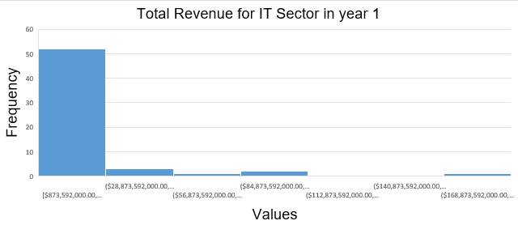
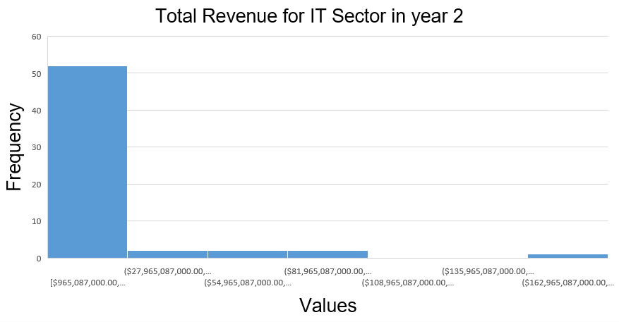
What are the changes in total revenue performance between the first and second years in the IT industry?
Here are the Histograms for the annual IT sector total revenue for all companies in years 1 & 2. Both distributions are right-skewed or positively skewed. That means the mean for each is higher than the median. The mean for year 1 is about 15.5 Billion, while year 2 decreased by approximately one hundred and fifty-five million. However, the median increased by almost 236M in year 2.Nevertheless, the first year recorded a standard deviation higher by 1.8 against year two. That means the variation for the first year is higher for IT companies. On the other hand, the greater range in the first year started to stabilizes somewhat in the second year, due to the increase in the minimum limit and the decrease in the maximum limit of the total revenue. Finally, 50% of the companies earn total revenue above 108 billion in year 2.

